Slide 1
A Primer and Overview
Modeling COVID-19
the presentation will begin shortly…
isee systems inc | (603) 448-4990 | www.iseesystems.com
Wheelock Office Park | 31 Old Etna Rd, Suite 7N | Lebanon, NH 03766 | US

Slide 2
A Primer and Overview
Modeling COVID-19
Presented by Bob Eberlein --- April 1, 2020
isee systems inc | (603) 448-4990 | www.iseesystems.com
Wheelock Office Park | 31 Old Etna Rd, Suite 7N | Lebanon, NH 03766 | US

Slide 3
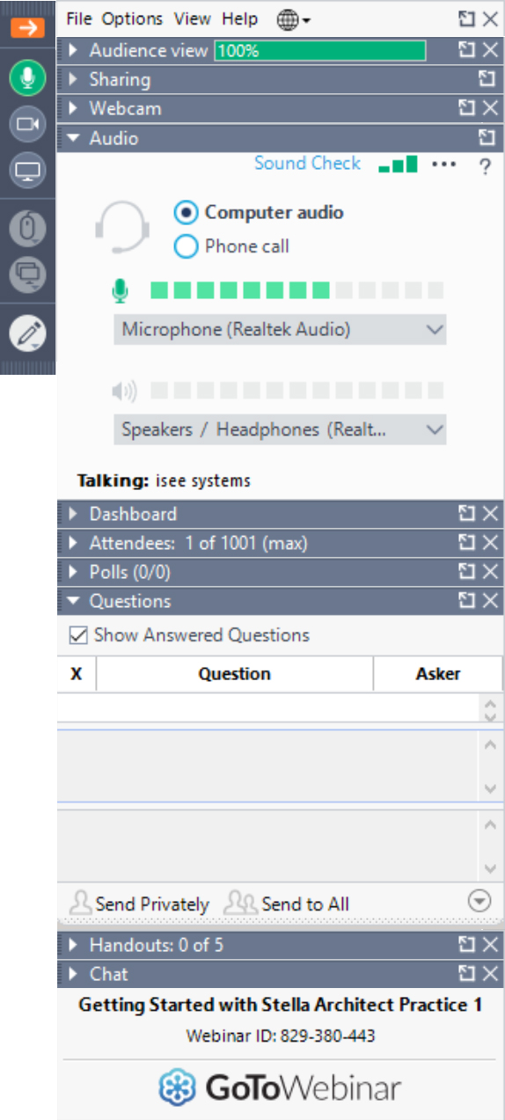
Webinar Mechanics
Grab tab
Enables you to hide or display control panel and toggle between full-screen and window mode
Audio setup
Allows you to test your audio
Also make sure your volume is turned up and your speakers are not muted.
Questions
Submit your questions here at anytime during the Webinar
isee systems inc | (603) 448-4990 | www.iseesystems.com
Wheelock Office Park | 31 Old Etna Rd, Suite 7N | Lebanon, NH 03766 | US

Slide 4
Today’s Topics
Background
Primer
Basic Diffusion
Standard SIR
Interventions
Overview – Issues and (some) Solutions
Distribution of transmissibility time
Clustering effects
Extinction
Viral Shedding Profile
Disease stages
Integrating health care
Including the economy
Q & A
4

Slide 5
Summary- Observations
Basic feedback is well understood
Refinements are helpful in creating useful models
Much is still mysterious
Models built afterward will be much better
5

Slide 6
Questions?
More information:
https://exchange.iseesystems.com/public/isee/covid-19-simulator
https://exchange.iseesystems.com/public/isee/modeling-covid-19-effectively https://exchange.iseesystems.com/public/stephanieglasser/covid-npi
https://iseesystems.com/resources/webinars/materials/covid-19-models-04-01.zip
https://blog.iseesystems.com/
Upcoming Webinar Topics:
Conveyors, Aging and Disease Progression
Using Stella to Trace Causality
6

Slide 7
Contact
Support
support@iseesystems.com
Bob Eberlein
beberlein@iseesystems.com
isee systems inc | (603) 448-4990 | www.iseesystems.com
Wheelock Office Park | 31 Old Etna Rd, Suite 7N | Lebanon, NH 03766 | US

Slide 8
Thank you!
Modeling COVID-19
isee systems inc | (603) 448-4990 | www.iseesystems.com
Wheelock Office Park | 31 Old Etna Rd, Suite 7N | Lebanon, NH 03766 | US

